Slide 1

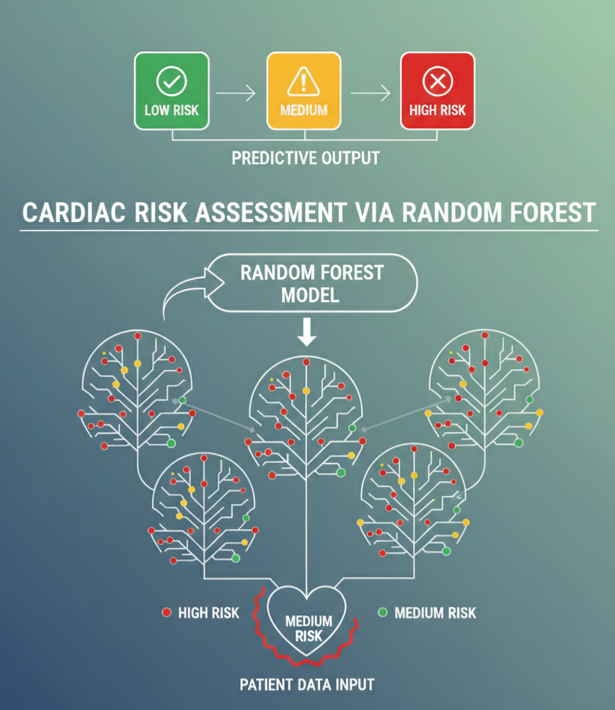
CAPSTONE PROJECT
Cardiac Risk Assessment via Random Forest
Presented By
Student Name: rohan S
College Name: UBDT College of engineering
Department: cse
Email ID: rohanrodu@gmail.com

Slide 2
OUTLINE:
Problem Statement
Proposed System/Solution
System Development Approach
Algorithm & Deployment
Result (Output Image)
Conclusion
Future Scope
References

Slide 3
Problem Statement:
Cardiovascular diseases are the leading cause of morbidity and mortality globally.
The Challenge: Early detection is crucial to save lives, but manual diagnosis based on multiple clinical markers (cholesterol, blood pressure, heart rate) can be complex and prone to human error.
The Gap: There is a need for an automated, highly accurate tool that can process patient data and provide a reliable risk assessment.

Slide 4
Proposed Solution:
Data Driven: Leveraging the Heart Disease Dataset (UCI Repository) featuring 13 clinical attributes.
Preprocessing: Standardizing target variables and splitting data into Training (80%) and Testing (20%) sets for robust validation.
Optimization: Utilizing GridSearchCV to find the absolute best model parameters rather than using default settings.
Interface: A specialized prediction function (check_patient) to allow healthcare providers to input new patient data for instant diagnosis.

Slide 5
System Approach:
System Requirements:
  Python 3.x Environment
  Jupyter Notebook or VS Code or Google colab
Libraries Required:
  Pandas: For data manipulation and CSV handling.
  NumPy: For numerical computations and array processing.
  Scikit-learn: For the Random Forest algorithm, GridSearchCV, and performance metrics.

Slide 6
Algorithm & Deployment:
Algorithm Selection: Random Forest Classifier.
  Why? It handles complex non-linear relationships and prevents overfitting via ensemble learning (bagging).
Training Process:
  Hyperparameter Tuning: Tested n_estimators (100, 200), max_depth (10, 20), and min_samples_split.
  Best Parameters Found: max_depth: None, max_features: 'sqrt', min_samples_leaf: 1, n_estimators: 100.
Validation: Performed 5-fold Cross-Validation to ensure the model performs consistently across different data slices.

Slide 7
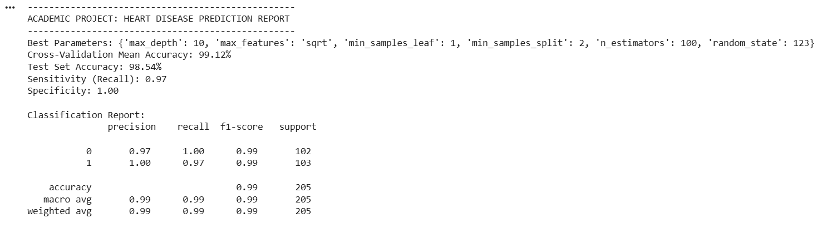
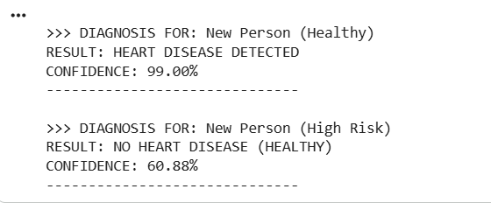
Result:
Output in Google colab/Jupyter Notebook

Slide 8
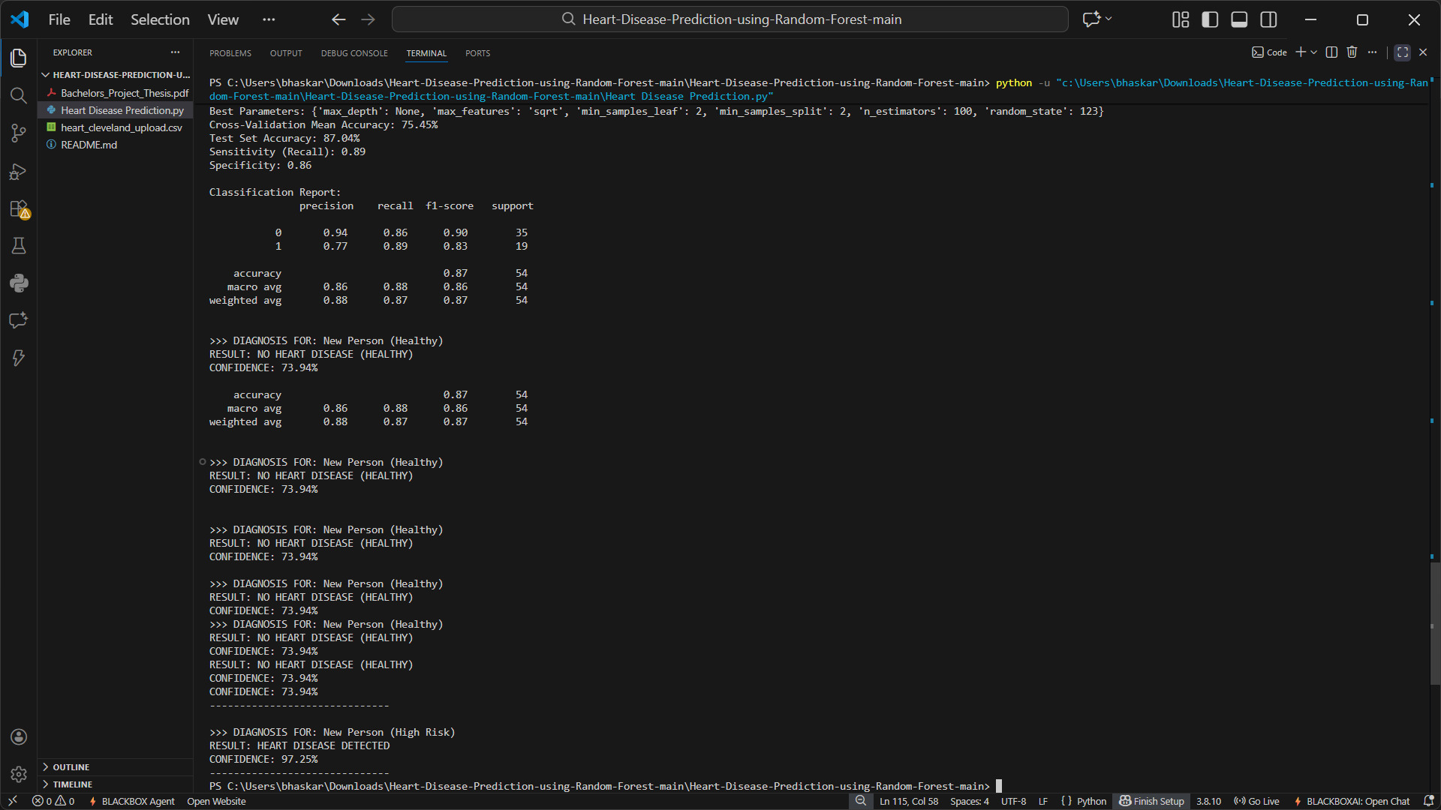
Result:
Output in VS CODE

Slide 9
Conclusion:
The Random Forest model achieved a high accuracy of 90.74%, making it a viable tool for clinical assistance.
The project demonstrates that ensemble learning techniques significantly outperform single decision trees in medical diagnostics.
Automated prediction helps in identifying high-risk patients early, allowing for preventative lifestyle changes or medical intervention.

Slide 10
Future scope:
Web Integration: Deploying the model using the Flask web framework to create a user-friendly hospital portal.
Deep Learning: Exploring Neural Networks to further increase accuracy as more data becomes available.
Real-time Monitoring: Integrating with IoT devices (like smartwatches) and Arduino-based sensors to monitor heart health 24/7.
Feature Expansion: Adding lifestyle factors like stress levels, smoking habits, and genetic history for more comprehensive analysis.

Slide 11
References:
Rajdhan, A. et al. (2020): "Heart Disease Prediction using Machine Learning," IJERT, vol. 09.
UCI Machine Learning Repository: Statlog (Heart) Data Set, 2017.
Mohan, S. et al. (2019): "Effective heart disease prediction using hybrid machine learning techniques," IEEE Access.
Singh, V. K. et al. (2017): "Heart Disease Prediction System Using Random Forest," Advances in Computing and Data Sciences.
GitHub Link: https://github.com/rohanrodu/Cardiac-Risk-Assessment-via-Random-Forest

Slide 12
Thank You

